Slide 1
Software Development Life Cycle (SDLC)
Ibtisam Mogul

Slide 2
Overview
SDLC Model
Waterfall Model
Spiral Model
Conclusion

Slide 3
Software Development Life Cycle (SDLC)
A structured step-by-step approach for developing information systems.
Process of formal, logical steps taken to develop a software product

Slide 4
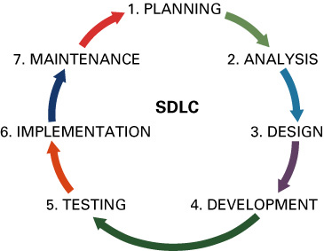
SYSTEMS DEVELOPMENT LIFE CYCLE (SDLC)
SDLC has 7 phases:
Planning
Analysis
Design
Implementation/ Development
Testing
Deployment/ Implementation
Maintenance

Slide 5
(cont’d)
Each of the phases is composed of steps, that produce deliverables (specific documents/ software that explain various elements of the system).

Slide 6
SDLC Phases
SDLC PHASE | ACTIVITIES
Planning | Define the system to be developed Set the project scope Develop the project plan
Analysis | Gather business requirements
Design | Design the technical architecture Design system models
Implementation/ Development | Build technical architecture Build databases and programs
Testing | Write test conditions Perform testing
Deployment/ Implementation | Write user documentation Provide training
Maintenance | Build a help desk Support system changes

Slide 7
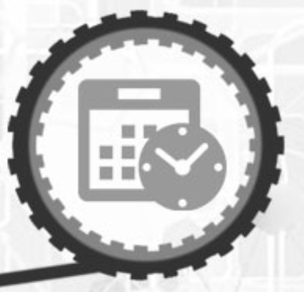
Phase1-Planning
“If you fail to plan, you are planning to fail”
- Benjamin Franklin
This phase is the fundamental process of understanding
why an information system should be built, and
determining how the project team will go about building it.

Slide 8
The planning phase has two steps:
During project initiation/ feasibility study, the system’s business value to the organization is identified (How will it lower costs or increase revenues?).
2. During project management, the project manager creates a work plan, staffs the project, and puts techniques in place to help the project team control and direct the project through the entire SDLC.

Slide 9
FEASIBILITY ANALYSIS
guides the organization in determining whether to proceed with a project.
identifies the important risks associated with the project that must be managed if the project is approved.

Slide 10
(cont’d)
Feasibility analysis includes techniques to assess areas:
Technical feasibility (Can we build it?)
Economic feasibility (Will it provide business value?)
Organizational feasibility (If we build it, will it be used?)
Schedule feasibility (Will we complete on time?)

Slide 11
Technical Feasibility
Technical feasibility is the extent to which the system can be successfully designed, developed, and installed by the IT group.
It is, in essence, a technical risk analysis that strives to answer the question: “Can we build it?”

Slide 12
(cont’d)
Risks can endanger the successful completion of a project. The following aspects should be considered:
Users’ and analysts’ should be familiar with the application.
Familiarity with the technology
Project size
Compatibility of the new system with the technology that already exists

Slide 13
Economic Feasibility
Economic feasibility analysis is also called a
cost-benefit analysis, that identifies the
costs and benefits associated with the system.
This attempts to answer the question:
“Should we build the system?”
(Will it provide value to business ?)

Slide 14
Cash Flow Analysis and Measures
IT projects involve an initial investment that produces a stream of benefits over time, along with some on-going support costs.
Cash flows, both inflows and outflows, are estimated over some future period.

Slide 15
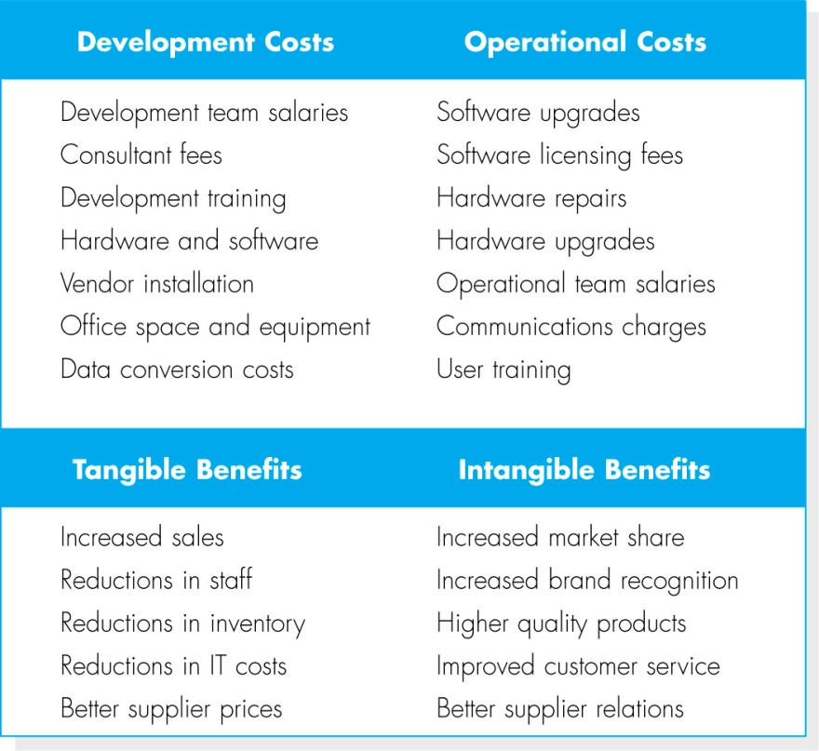
Identify Costs and Benefits
The costs and benefits
four categories:
Development costs
Operational costs
Tangible benefits
Intangibles

Slide 16
Organizational Feasibility
Organizational feasibility of the system is
how well the system will be accepted by its users and
incorporated into the ongoing operations of the organization.
Organizational feasibility can be the most difficult to assess.
Organizational feasibility analysis is to answer the question
If we build it, will it be used?

Slide 17
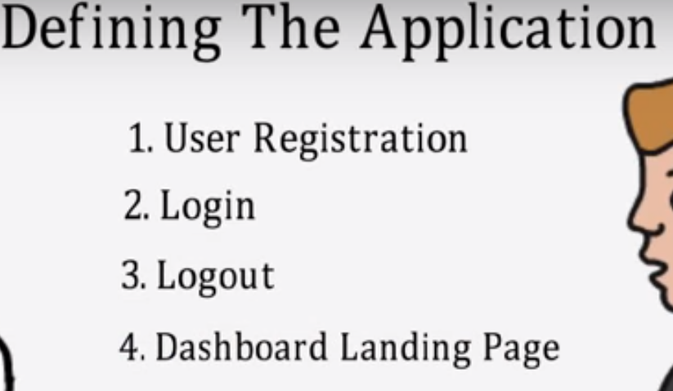
Phase 1: Planning
Set the project scope
Project scope - clearly defines the high-level system requirements
Project scope document - a written definition of the project scope and is usually no longer than a paragraph

Slide 18
Phase 1: Planning
Develop the project plan including tasks, resources, and timeframes
Project plan - defines the what, when, and who questions of system development
Project manager - an individual who is an expert in project planning and management, defines and develops the project plan and tracks the plan to ensure all key project milestones are completed on time
Project milestones - represent key dates for which you need a certain group of activities performed

Slide 19
Cost estimation
Resource allocation (both human and materials)
Capacity planning
Project scheduling
Outputs : project plans, schedules, cost estimations, and procurement requirements.

Slide 20
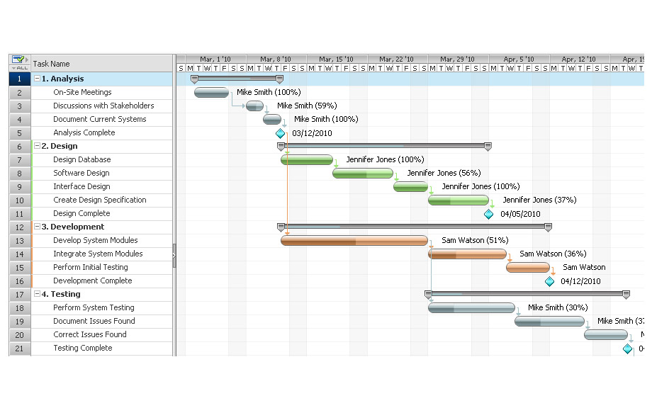

Slide 21
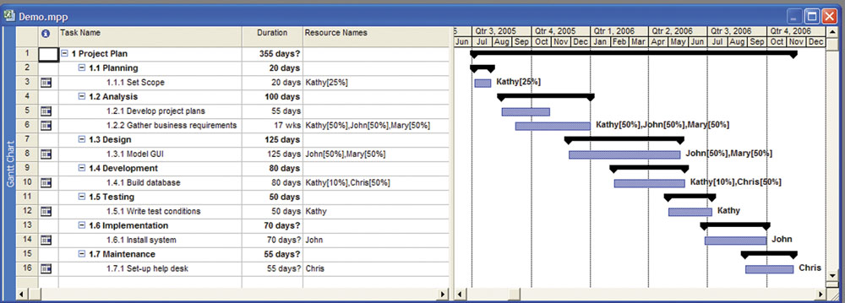
Phase 1: Planning

Slide 22
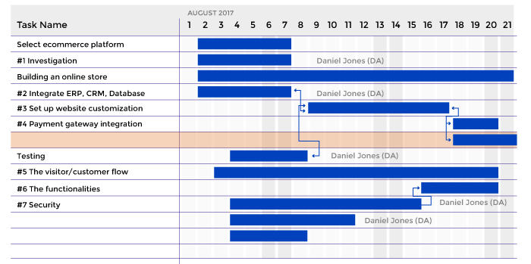

Slide 23
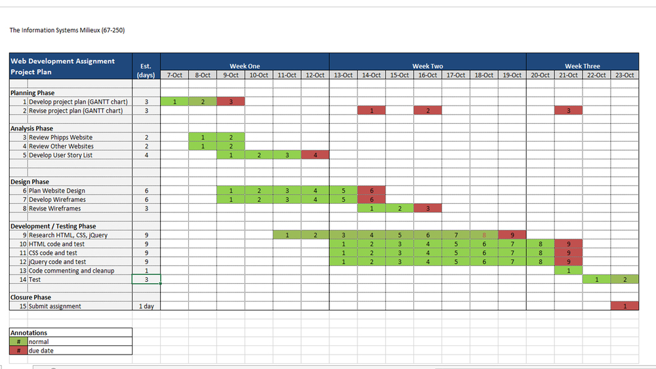

Slide 24
Phase 2: Analysis
Involves end users and IT specialists working together to
gather
understand and
document
the business requirements for the proposed system

Slide 25
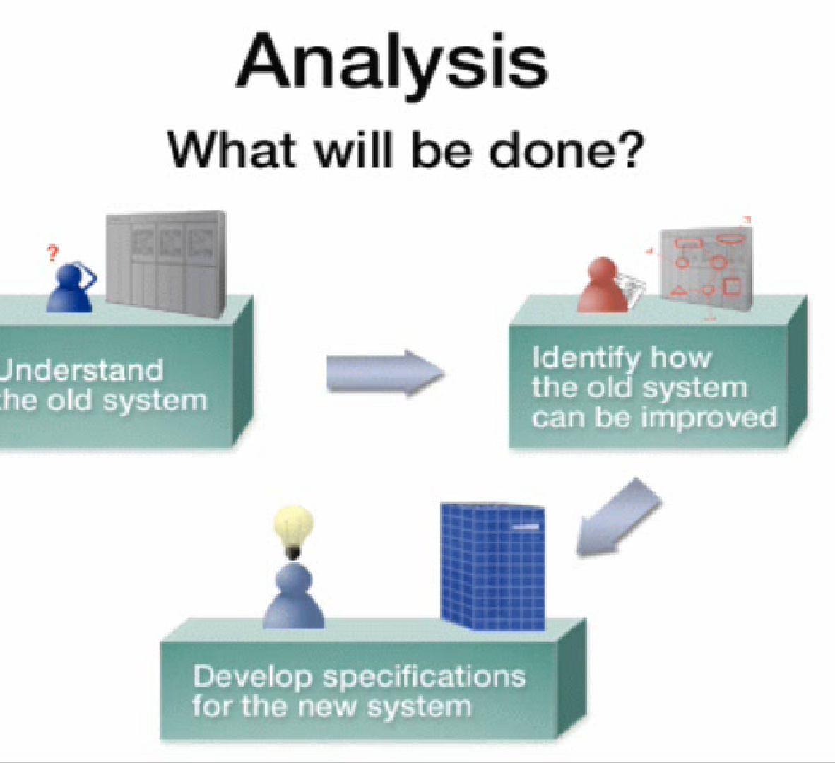
Analysis
The analysis phase answers the questions of
who will use the system,
what the system will do, and
where and when it will be used.
During this phase the project team investigates
any current system(s),
identifies improvement opportunities, and
develops a concept for the new system.

Slide 26
The analysis phase has three steps:
1. Analysis strategy: This is developed to guide the projects team’s efforts. This includes a study of the current system and its problems, and envisioning ways to design a new system.
2. Requirements gathering: The analysis of this information leads to the development of a concept for a new system. This concept is used to build a set of analysis models.
3. System proposal: The proposal is presented to the project sponsor and other key individuals who decide whether the project should continue to move forward.

Slide 27
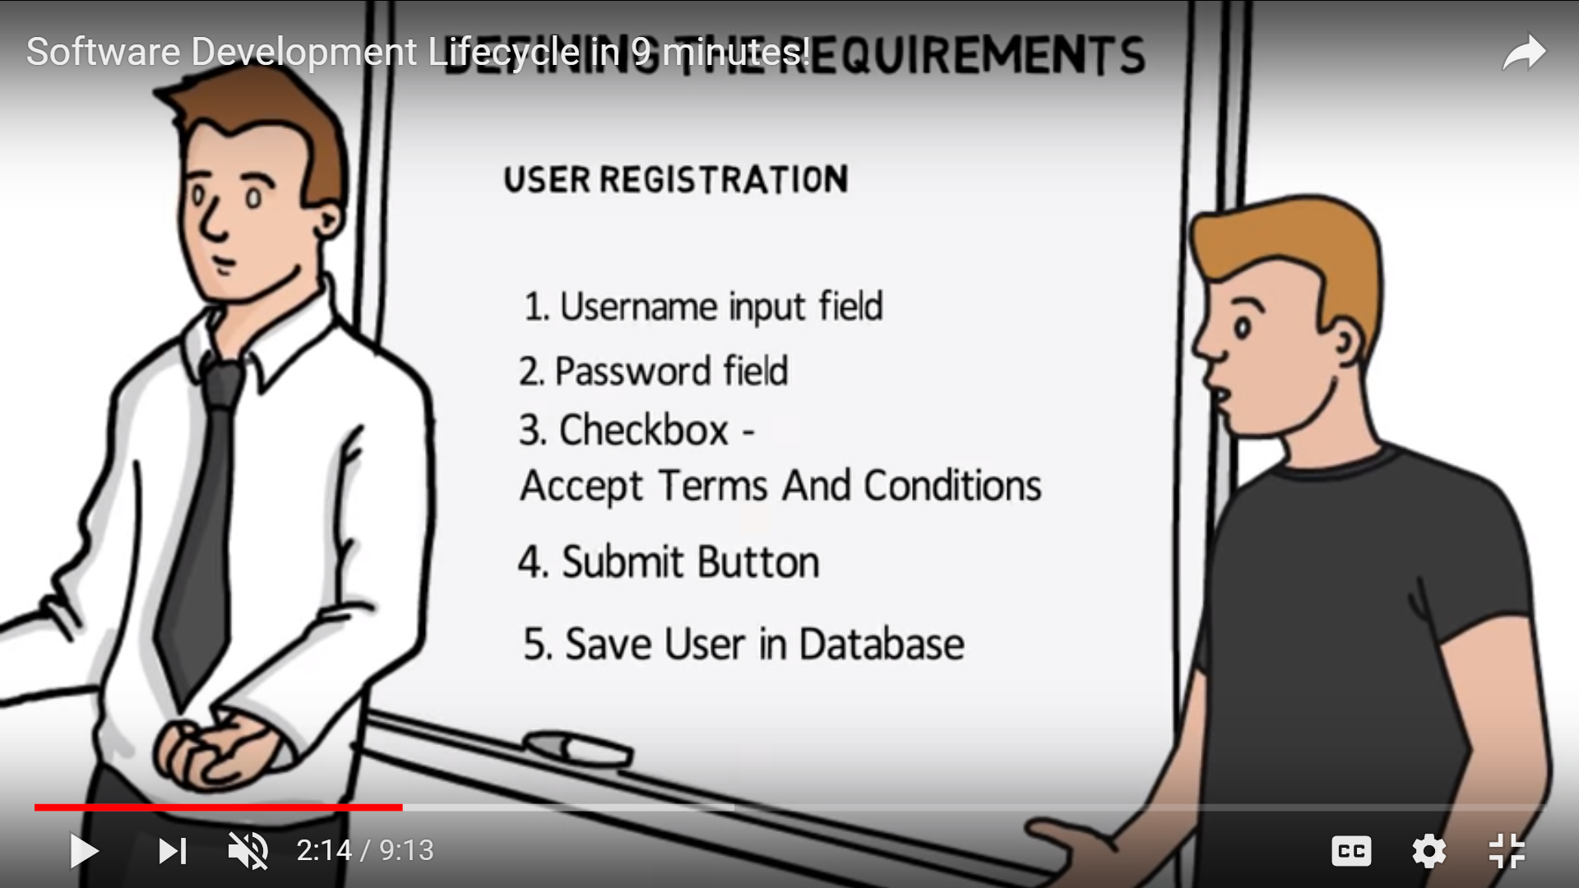
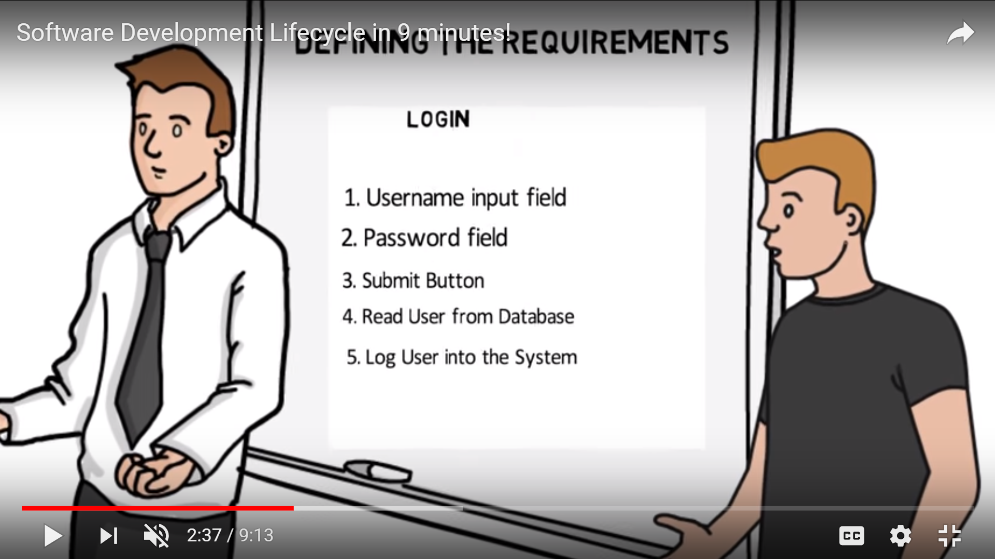
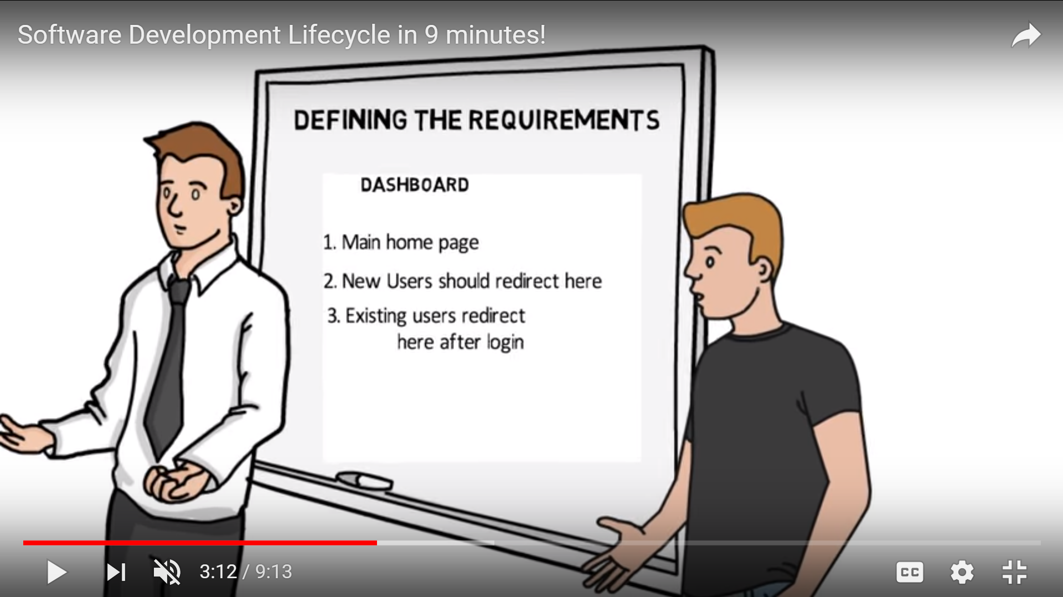

Slide 28
Design
The design phase decides
how the system will operate, in terms of
the hardware, software, and network infrastructure;
the user interface, forms, and reports that will be used; and
the specific programs, databases, and files that will be needed.

Slide 29
The design phase has four steps:
1. Design Strategy: This clarifies whether the system will be developed by the company or outside the company.
2. Architecture Design: This describes the hardware, software, and network infrastructure that will be used.
3. Database and File Specifications: These documents define what and where the data will be stored.
4. Program Design: Defines what programs need to be written and what they will do.

Slide 30
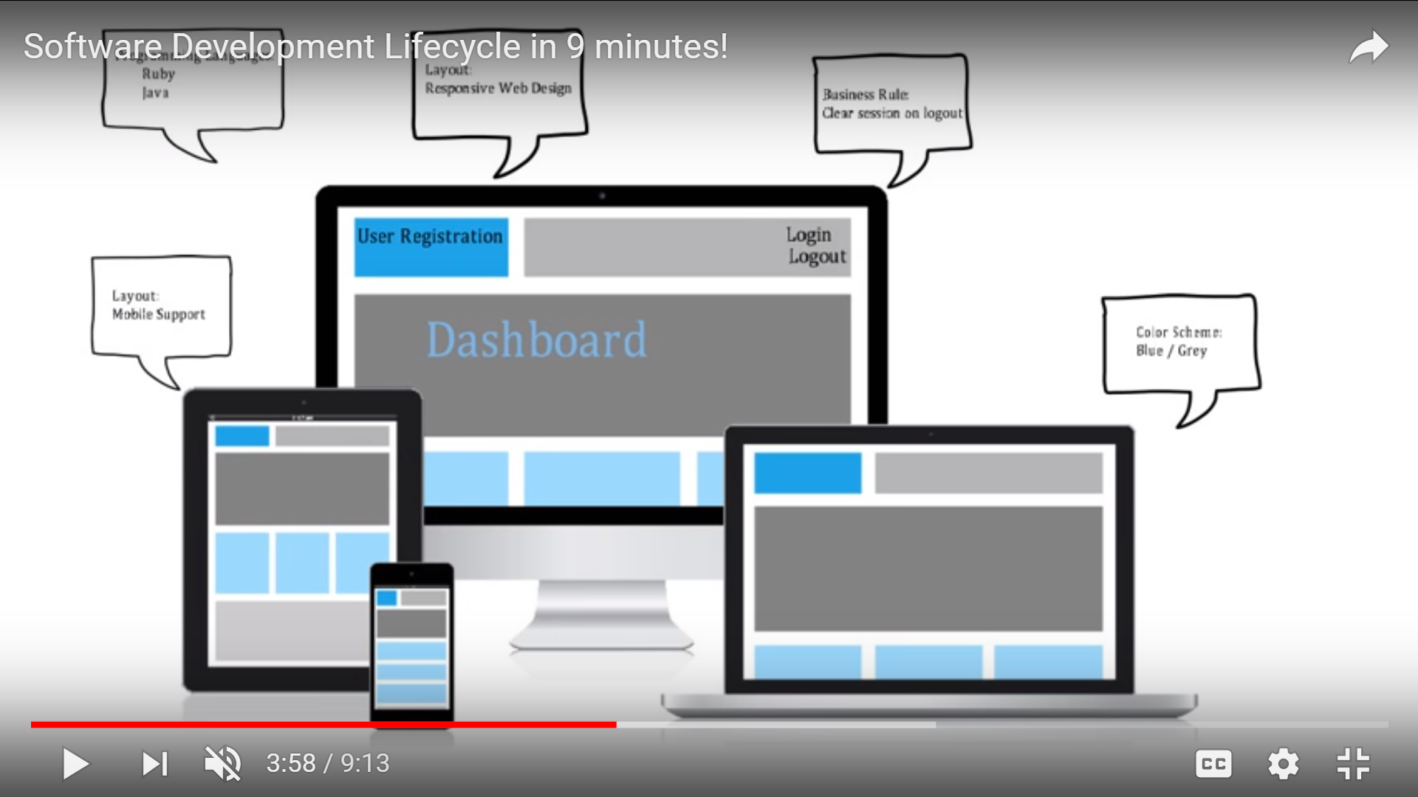

Slide 31
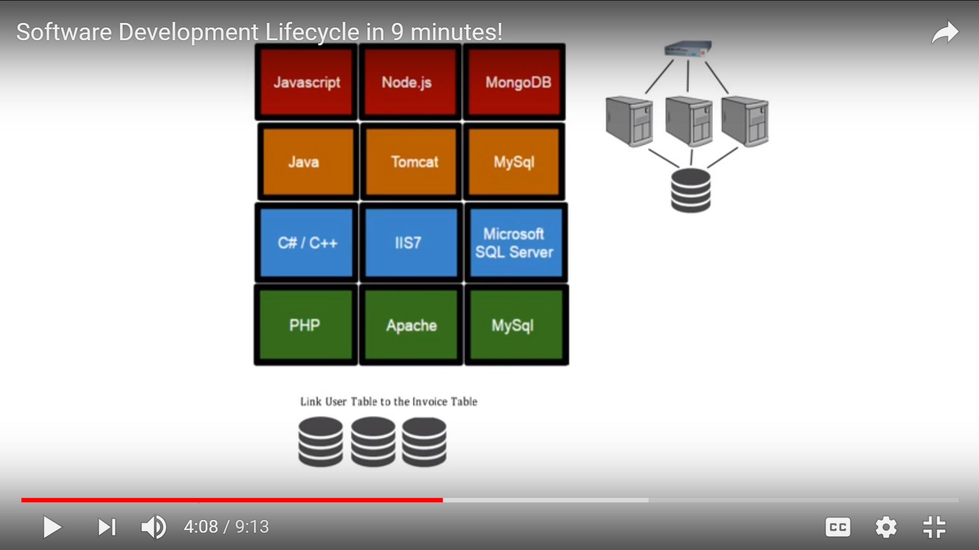
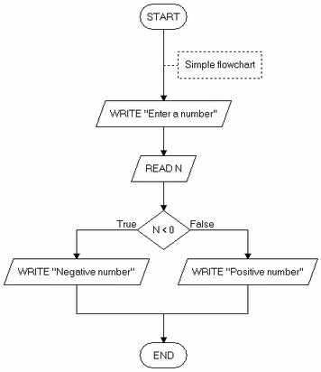
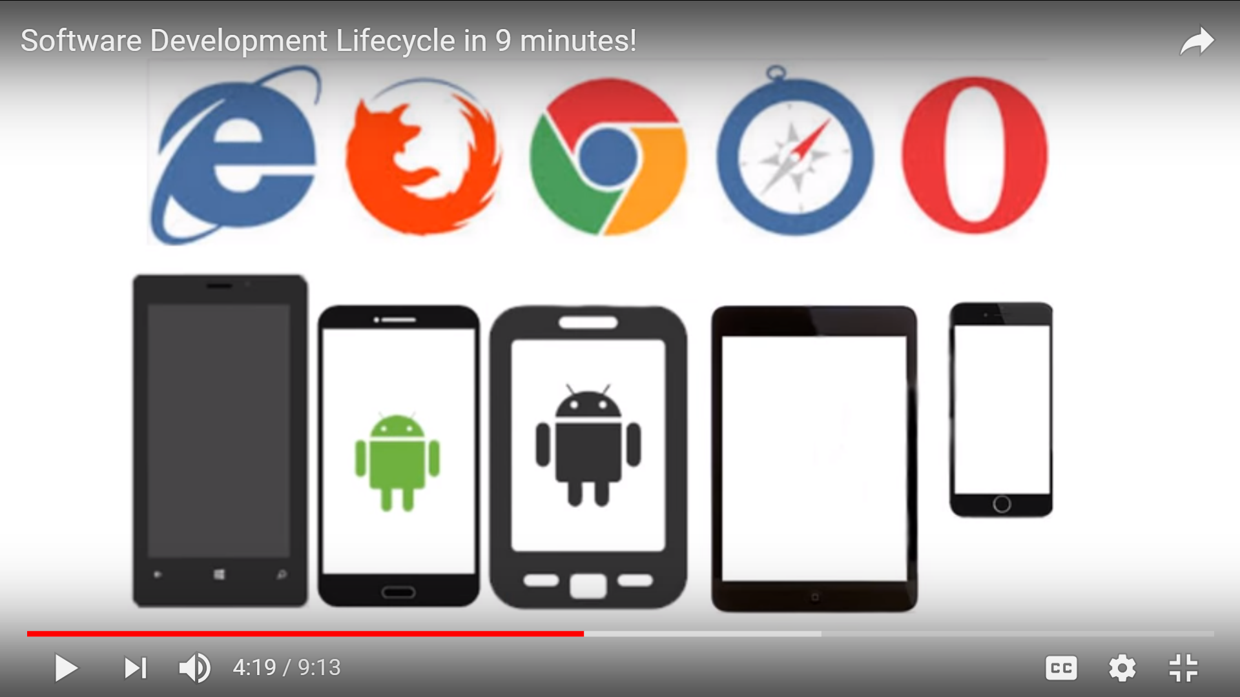

Slide 32
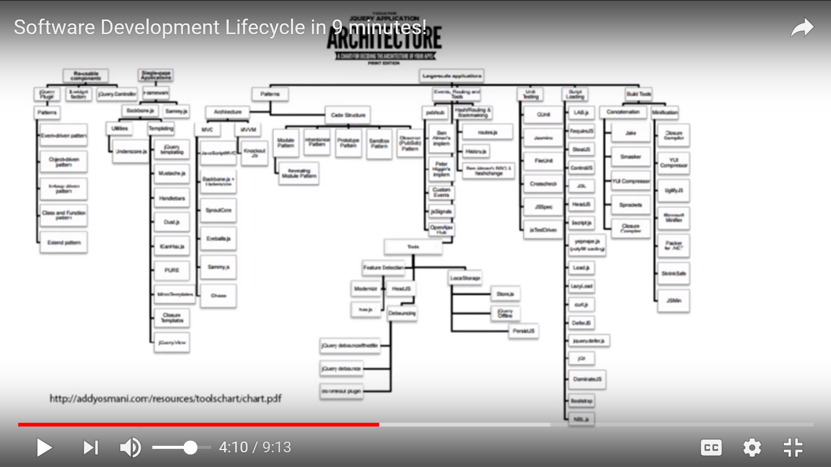

Slide 33
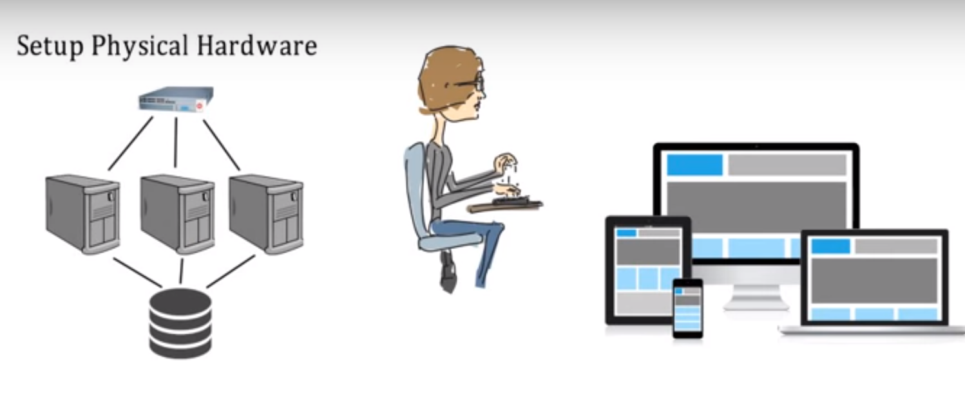
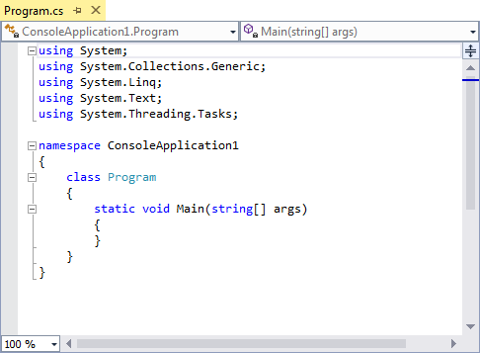
Phase 4: Implementation/Development
Development phase - take all of your detailed design documents from the design phase and transform them into an actual system
Build the interface, database and programs (Coding)
performed by IT specialists

Slide 34
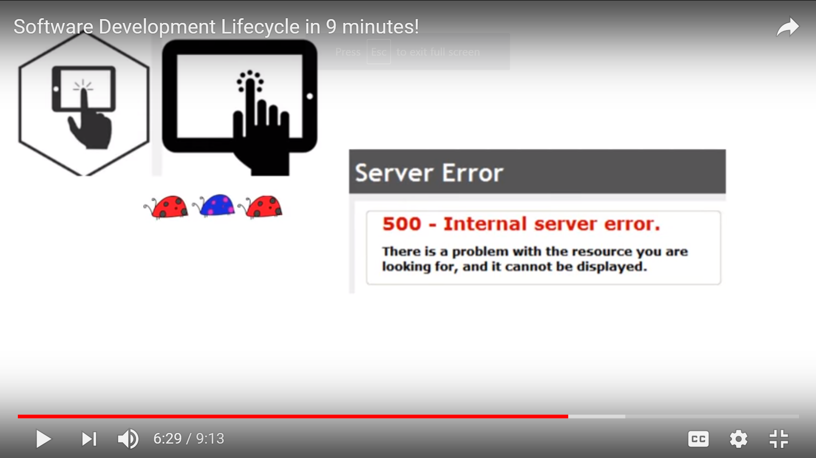
Phase 5: Testing
Testing phase - verifies that the system works and meets all of the business requirements defined in the analysis phase
Two primary testing activities:
Create Test Cases and write the test conditions
Test conditions - the detailed steps the system must perform along with the expected results of each step
Perform the testing of the system

Slide 35
Phase 5: Testing
Perform the testing of the system
Unit testing – tests individual units of code
Integration testing – verifies that separate systems work together
System testing – verifies that the units of code function correctly when integrated
User acceptance testing (UAT) – determines if the system satisfies the business requirements

Slide 36
Phase 6: Deployment
Distribute the system to all of the knowledge workers and they begin using the system to perform their everyday jobs
Two primary implementation activities
Write detailed user documentation
User documentation - highlights how to use the system
Provide training for the system users
Online training - runs over the Internet or off a CD-ROM
Workshop training - is held in a classroom environment and lead by an instructor

Slide 37
Phase 7-maintenance
Systems need to be reviewed or evaluated periodically to ensure that they meet user’s needs.
A critical evaluation may become the starting point for a new whole cycle of IS development.
More often, evaluation will result in some proposed changes and amendments to a system: an activity know as maintenance

Slide 38
Reasons for maintenance
To correct software errors.
To enhance the software’s capabilities

Slide 39
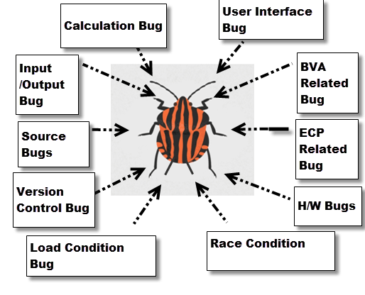
Reasons for maintenance
A. To correct software errors.
bugs or errors creep into
computer programs.
Bugs (“known anomalies”)
are corrected when
new versions of the
software are
released.
Notes:
A. To correct software errors.
No matter how thoroughly the
system is tested,
bugs or errors creep into
computer programs.
Bugs in commercial PC software
are often documented as
“known anomalies,” and
are corrected when new versions of the software are released or in an interim release.
In custom software (also called bespoke software), bugs must be corrected as they are detected.

Slide 40
Reasons for maintenance
B. To enhance the software’s capabilities
Changing organizational needs,
Due to the following situations:
Users often request additional features after they become familiar with the computer system and its capabilities.
2. The business changes over time.
3. Hardware and software are changing at an accelerated pace.

Slide 41
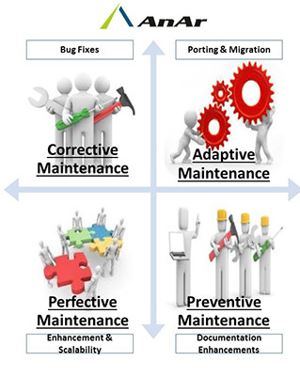
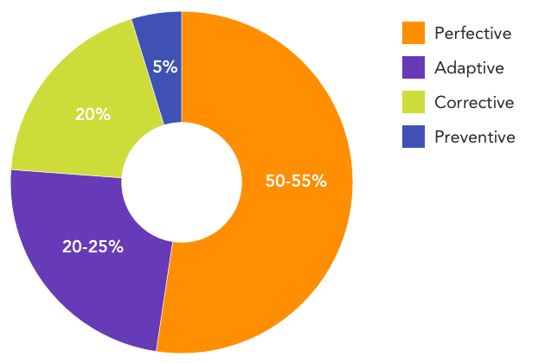
Types of maintenance
Corrective maintenance
Perfective maintenance
Adaptive maintenance
Preventive maintenance
Notes:
http://www.anarsolutions.com/types-of-software-maintenance/

Slide 42
Types of maintenance
Corrective maintenance
customer will uncover defects in the software.
Cr. M. intends to correct faults in the developed system.
Notes:
Three types of maintenance:
A. Corrective maintenance:
customer will uncover defects in the software.
CM intends to correct faults in the developed system.
B. Perfective maintenance:
As software is used, the customer/user will recognize additional
functions that will provide benefit.
PM extends the software beyond its original functional requirements.
provide or improve features that should have been specified but were not.

Slide 43
Types of maintenance
A. Corrective maintenance (contd…)
A defect can result due to errors in software design, logic and coding.
Design errors occur when changes made to the software are incorrect, incomplete, wrongly communicated, or the change request is misunderstood.
Logical errors result from invalid tests and conclusions, incorrect implementation of design specifications, faulty logic flow, or incomplete test of data.
Notes:
http://ecomputernotes.com/software-engineering/types-of-software-maintenance

Slide 44
Types of maintenance
B. Perfective maintenance
Customer/user will recognize additional functions that will provide benefit.
Provide or improve features.
modifying the payroll program to incorporate a new report in the sales analysis system.
Re-organizing data sets within a database so they can be searched faster or use less storage or providing shortcuts commands that experts can use instead of the slower standard menu system.
Notes:
Three types of maintenance:
A. Corrective maintenance:
customer will uncover defects in the software.
CM intends to correct faults in the developed system.
B. Perfective maintenance:
As software is used, the customer/user will recognize additional
functions that will provide benefit.
PM extends the software beyond its original functional requirements.
provide or improve features that should have been specified but were not.

Slide 45
Types of maintenance
Adaptive maintenance:
Original environment for which the software was developed is likely to change.
e.g., CPU, operating system, business rules, external product characteristics
Modification to the software to accommodate changes to its external environment.
Examples:
Utility Moving to the Clouds
Government recently introduced VAT rate
Notes:
https://endertech.com/blog/maintenance-bug-fixing-4-types-maintenance
http://www.anarsolutions.com/types-of-software-maintenance/
Three types of maintenance:
Adaptive maintenance:
making changes that are required to meet changed requirements
Over time, the original environment (e.g., CPU, operating system,
business rules, external product characteristics) for which the software was developed is likely to change. Adaptive maintenance results in modification to the software to accommodate changes to its external environment.

Slide 46
Maintenance-Conclusion
One of the main reason of analysis and design phase is to produce good documentation that will make maintenance easy.
Design of a systems (high quality, well documented)
-> Easier to Maintain .
Cost of maintenance over the full working life of a system can be very high

Slide 47
SDLC Model
A framework that describes the activities performed at each stage of a software development project.

Slide 48
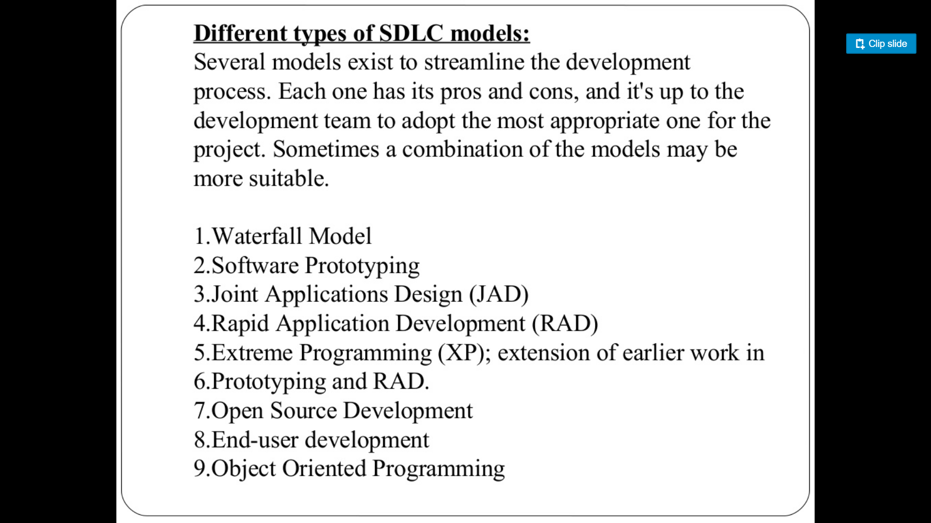
Waterfall Model
Spiral Model

Slide 49
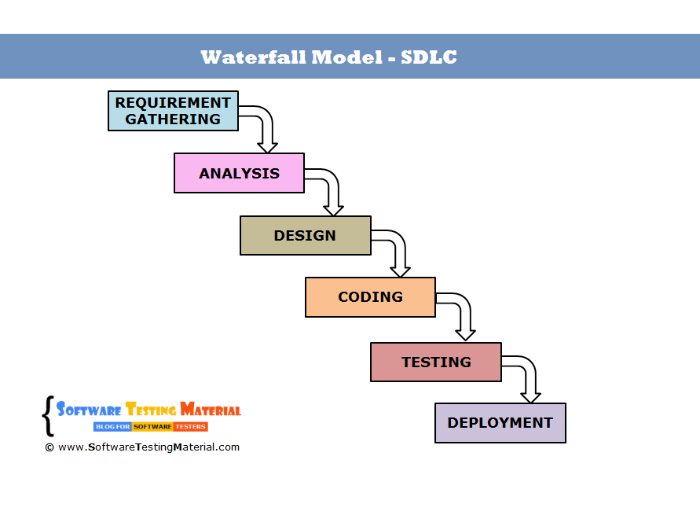
Waterfall Model
Requirements – defines needed information, function, behavior, performance and interfaces.
Design – data structures, software architecture, interface representations, algorithmic details.
Implementation – source code, database, user documentation, testing.

Slide 50
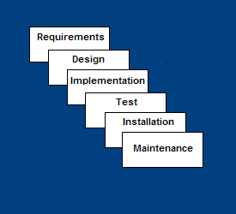
Waterfall Model
Test – check if all code modules work together and if the system as a whole behaves as per the specifications.
Installation – deployment of system, user-training.
Maintenance – bug fixes, added functionality (an on-going process).

Slide 51
Waterfall Strengths
Easy to understand, easy to use
Provides structure to inexperienced staff
Milestones are well understood
Sets requirements stability
Good for management control (plan, staff, track)
Works well when quality is more important than cost or schedule

Slide 52
Waterfall Deficiencies
All requirements must be known upfront
Deliverables created for each phase are considered frozen – inhibits flexibility
Can give a false impression of progress
Does not reflect problem-solving nature of software development – iterations of phases
Integration is one big bang at the end
Little opportunity for customer to preview the system (until it may be too late)

Slide 53
When to use the Waterfall Model
Requirements are very well known
Product definition is stable
Technology is understood
New version of an existing product
Porting an existing product to a new platform.

Slide 54
Project and Requirements Planning – allocate resources
Product Requirements and Specification Analysis – complete specification of the software system
Architecture or High-Level Design –
defines how software functions or components (datastore/ user/ hardware devices) interact with each other to fulfill the requirements
Detailed Design – develop algorithms for each architectural component

Slide 55
Coding – transform algorithms into software[Programming/ Writing queries]
Unit testing – check that each module acts as expected
Integration and Testing – check that modules interconnect correctly
System and acceptance testing – check the entire software system in its environment
Production, operation and maintenance – provide for enhancement and corrections
Notes:
https://www.slideshare.net/mitwa1990/library-management-system-waterfall-model
https://www.slideshare.net/shahaditya/library-management-system-31197877

Slide 56
Emphasize planning for verification and validation of the product in early stages of product development
Each deliverable must be testable
Project management can track progress by milestones
Easy to use

Slide 57
Spiral SDLC Model
Adds risk analysis, and 4gl RAD prototyping to the waterfall model
Each cycle involves the same sequence of steps as the waterfall process model

Slide 58
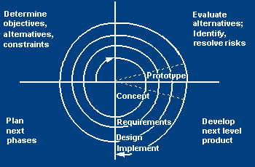
Spiral SDLC Model

Slide 59
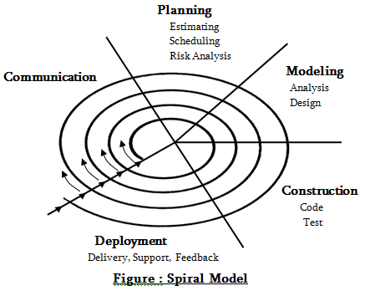
Spiral SDLC Model

Slide 60
Spiral Quadrant Determine objectives, alternatives and constraints
Objectives: functionality, performance, hardware/software interface, critical success factors, etc.
Alternatives: build, reuse, buy, sub-contract, etc.
Constraints: cost, schedule, man-power, experience etc.

Slide 61
Spiral Quadrant Evaluate alternatives, identify and resolve risks
Study alternatives relative to objectives and constraints
Identify risks (lack of experience, new technology, tight schedules, etc.)
Resolve risks

Slide 62
Spiral Quadrant Develop next-level product
Typical activites:
Create a design
Review design
Develop code
Inspect code
Test product

Slide 63
Spiral Quadrant Plan next phase
Typical activities
Develop project plan
Develop a test plan
Develop an installation plan

Slide 64
Spiral Model Strengths
Provides early indication of insurmountable risks, without much cost
Users see the system early because of rapid prototyping tools
Critical high-risk functions are developed first
Users can be closely tied to all lifecycle steps
Early and frequent feedback from users

Slide 65
Spiral Model Weaknesses
Time spent for evaluating risks too large for small or low-risk projects
Time spent planning, resetting objectives, doing risk analysis and prototyping may be excessive
The model is complex
Risk assessment expertise is required
Spiral may continue indefinitely
Developers must be reassigned during non-development phase activities

Slide 66
When to use Spiral Model
When creation of a prototype is appropriate
When costs and risk evaluation is important
For medium to high-risk projects
Users are unsure of their needs
Requirements are complex
New product line
Significant changes are expected

Slide 67
Tailored SDLC Models
No single model fits all projects
If there is no suitable model for a particular project, pick a model that comes close and modify it for your needs.
If project should consider risk but complete spiral model is too much – start with spiral and simplify it
Each team must pick or customize a SDLC model to fit its project

Slide 68
Quality – the degree to which the software satisfies stated and implied requirements
Absence of system crashes
Correspondence between the software and the users’ expectations
Adherence to specified requirements
Quality must be controlled because it lowers production speed, increases maintenance costs and can adversely affect business
the good enough is enemy of the excellent

Slide 69
Quality Assurance Plan
The plan for quality assurance activities should be in writing so all stakeholders can review it during the lifecycle.
Some elements that should be considered by the plan are: defect tracking, unit testing, source-code tracking, integration testing and system testing.

Slide 70
Quality Assurance Plan
Defect tracing – keeps track of each defect found, its source, when it was detected, when it was resolved, how it was resolved, etc
Unit testing – each individual module is tested
Source code tracing – step through source code line by line
Integration testing - test new code in combination with code that already has been integrated
System testing – execution of the software for the purpose of finding defects.

Slide 71
Conclusion
SDLC
A framework that describes the activities performed at each stage of a software development project.
Waterfall need requirements to be known up-front.
E.g. when creating new versions of existing systems.
Spiral models do not need all requirements to be known
E.g. New systems.
Uses series of prototypes that evolve into the finished system.

Slide 72
References
http://condor.depaul.edu/~jpetlick/extra/394/Session2.ppt
Software Engineering: A Practitioner's Approach, Roger Pressman [Software Process Models]

Slide 73
API
Contents
Need for API
API technologies
API evaluation criteria (security, functionality, usability)

Slide 74
Application programming interface
An application programming interface (API) is a specification intended to be used as an interface by software components to communicate with each other.
An API may include specifications for
routines, data structures, object classes, and variables.
An API specification can take many forms like:
International Standard such as HTTP or
Vendor documentation such as the Microsoft Windows API,
or the libraries of a programming language,
e.g. Standard Template Library in C++ or Java API.

Slide 75
API’s
API is a set of commands, functions and protocols which programmers can use when building a software.
It allows the programmers to use predefined functions to interact with systems, instead of writing them from scratch.
Characteristics of good API
Easy to learn and use, Hard to misuse.
Easy to read and maintain code that uses it.
Is programming language neutral.
Sufficiently powerful to support all computational requirements.

Slide 76
Detailed explanation
An API may describe the ways in which a particular task is performed.
In procedural languages like C language the
action is usually mediated by a function call.
Hence the API usually includes a description of all the functions/routines it provides.
The term API may be used to refer to a complete interface, a single function, or even a set of APIs provided by an organization.
Thus, the scope of meaning is usually determined by the context of usage.

Slide 77
Example
math.h file of C language contains the definition of the function prototypes of the mathematical functions available in the C language library for mathematical processing.
This file - describes how to use the functions in the given library.
Function prototype - signature that describes the number and types of the parameters to be passed to the functions and the type of the return value.
Behavior of the functions is usually described in more details in a human readable format in printed books or in electronic formats

Slide 78
#include <math.h>
double sqrt(double X);
float sqrtf(float X);
DESCRIPTION
sqrt computes the positive square root of the argument. ...
RETURNS
On success, the square root is returned. If X is real and positive...
the function returns the square root of a positive floating point number (single or double precision) as another floating point number.
Hence the API in this case can be interpreted as the collection of the Application programming interface 2 include files used by the C language and its human readable description provided.

Slide 79
Language used
An API can be:
language-dependent, meaning it is only available by using the syntax and elements of a particular language, which makes the API more convenient to use.
language-independent, written so that it can be called from several programming languages. This is a desirable feature for a service-oriented API that is not bound to a specific process or system and may be provided as remote procedure calls or web services.
Ex, a website that allows users to review local restaurants is able to layer their reviews over maps taken from Google Maps, because Google Maps has an API that facilitates this functionality. Google Maps' API controls what information a third-party site can use and how they can use it.

Slide 80
API can be defined as a set of rules that determine how one software communicates with another.
The huge benefit is that APIs can work with any common programming language, which makes them a convenient and easy to understand tool for the developers.
Notes:
https://www.data2crm.com/api/blog/general/need-api-beginners-guide-api-technology/

Slide 81
Approach to delivering web APIs is REST,
REepresentational State Transfer.
REST utilizes the same mechanisms that are applied to view regular web pages.
REST API allows you to reach data and functionality already available in one app
and, through another API, make them accessible to other web and mobile applications.
After that API can return the data in the following formats:
XML , JSON [XML – Extensible Markup Language
JSON – JavaScript Object Notation]
Data, delivered in any of the two formats can be easily accessed by developers and non-developer alike, since it can be smoothly transferred to spreadsheets and similar tools.
Notes:
https://www.data2crm.com/api/blog/general/need-api-beginners-guide-api-technology/

Slide 82
How Can API Be Useful for Software Developers?
API is one of the crucial tools,
every app should leverage to stay competitive in current markets.
The reason for this being the ability of an API to create a whole new form of web presence and make your data accessible to other public and private applications, as well as allow you to integrate with those apps that also provide an API.
Notes:
https://www.data2crm.com/api/blog/general/need-api-beginners-guide-api-technology/

Slide 83
Advantages of using API for developers and software providers:
Accelerating application development process through eliminating the need to build individual integration methods for every desired application
Increasing the app’s functionality by providing the access to the data from other solutions
Expanding the potential client circle by attracting the users of integrated tools.
APIs allow to include lots of additional functions into your app by simply adding a few lines of code.
Notes:
https://www.data2crm.com/api/blog/general/need-api-beginners-guide-api-technology/

Slide 84
API Integration
Even though API is a handy method to use for integration, establishing the connection even with a single API can be somewhat tricky.
But what if you want to integrate with multiple APIs?
The process consists of multiple stages, such as on-boarding, exploration, education, authentication, code samples, testing, monitoring and sandboxing.
Notes:
https://www.data2crm.com/api/blog/general/need-api-beginners-guide-api-technology/

Slide 85
API Technologies

Slide 86
Different Types of APIs
There are many different types of APIs for :
operating systems, applications or websites.
Windows has many API sets that are used by system hardware and applications
when you copy and paste text from one application to another, it is the API that allows that to work.
APIs allow programmers to write applications consistent with the operating environment.
APIs are also specified by websites.
Example, Amazon or eBay APIs allow developers to use the existing retail infrastructure to create specialized web stores. Third-party software developers also use Web APIs to create software solutions for end-users. (Use of Paypal to perform money transactions online)

Slide 87
Google Maps API: Google Maps APIs lets developers embed Google Maps on webpages using a JavaScript or Flash interface. The Google Maps API is designed to work on mobile devices and desktop browsers.
2. YouTube APIs: YouTube API: Google's APIs lets developers integrate YouTube videos and functionality into websites or applications. YouTube APIs include the YouTube Analytics API, YouTube Data API, YouTube Live Streaming API, YouTube Player APIs and others.
3. Flickr API: The Flickr API is used by developers to access the Flick photo sharing community data. The Flickr API consists of a set of callable methods, and some API endpoints.
4. Amazon Product Advertising API: Amazon's Product Advertising API gives developers access to Amazon's product selection and discovery functionality to advertise Amazon products to monetize a website.
Notes:
www.webopedia.com/TERM/A/API.html

Slide 88
API Evaluation Criteria
security,
functionality,
usability
Notes:
https://www.youtube.com/watch?v=aAb7hSCtvGw

Slide 89
Security of API
Example Attack Scenarios
Scenario #1: Imagine a mobile banking app that connects to an XML API at the bank for account information and performing transactions. The attacker reverse engineers the app and discovers that the user account number is passed as part of the authentication request to the server along with the username and password. The attacker sends legitimate credentials, but another user’s account number, gaining full access to the other user’s account.
Notes:
https://www.owasp.org/index.php/Top_10_2017-A10-Underprotected_APIs

Slide 90
Security of API
Example Attack Scenarios
Scenario #2 Imagine a public API offered by an Internet startup for automatically sending text messages. The API accepts JSON messages that contain a “transactionid” field. The API parses out this “transactionid” value as a string and concatenates it into a SQL query, without escaping or parameterizing it. As you can see the API is just as susceptible to SQL injection as any other type of application.
In either of these cases, the vendor may not provide a web UI to use these services, making security testing more difficult.
Notes:
https://www.owasp.org/index.php/Top_10_2017-A10-Underprotected_APIs

Slide 91
How Do I Prevent 'Underprotected APIs'?
The key to protecting APIs is to ensure that you fully understand the threat model and what defenses you have:
Ensure that you have secured communications between the client and your APIs.
Ensure that you have a strong authentication scheme for your APIs, and that all credentials, keys, and tokens have been secured.
Ensure that whatever data format your requests use, that the parser configuration is hardened against attack.
Implement an access control scheme that protects APIs from being improperly invoked, including unauthorized function and data references.
Protect against injection of all forms, as these attacks are just as viable through APIs as they are for normal apps.
Be sure your security analysis and testing covers all your APIs and your tools can discover and analyze them all effectively.

Slide 92
Notes:
ftp://ftp.inf.puc-rio.br/pub/docs/FomularioSolicitacoes/LuisMarques-12-13-51514.pdf

